Slide 1
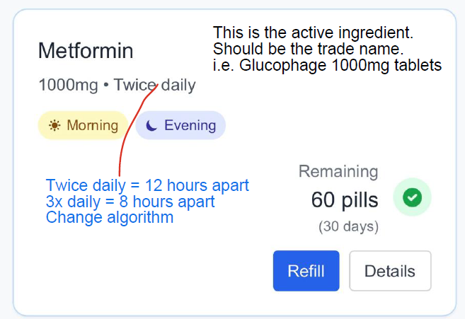
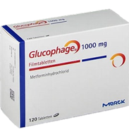
Glucophage | 1000mg | tablets
Format
Trade name | strength | dosage form |
Actice Pharmaceutical Ingredient (API)
Metformin
Twice daily
☼
Morning
☾
40 tablets remaining
20 days supply
Evening
Refill
Glucophage | 1000mg | tablets
Glucophage | 1000mg | tablets
Metformin
Twice daily
Metformin
Twice daily
☼
10 tablets remaining
5 days supply
Morning
☼
☾
Morning
Evening
20 days remaining
☾
Evening
Remaining
40 tablets
(20 days)
Refill

Slide 2
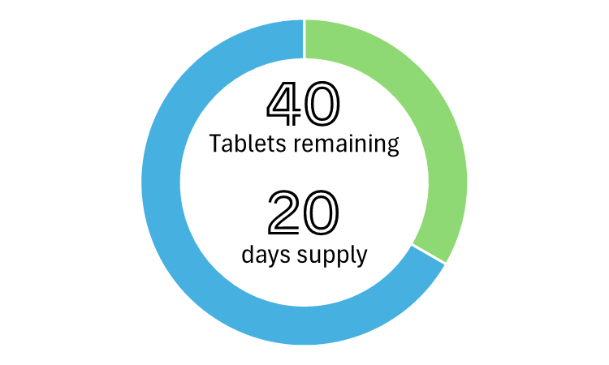
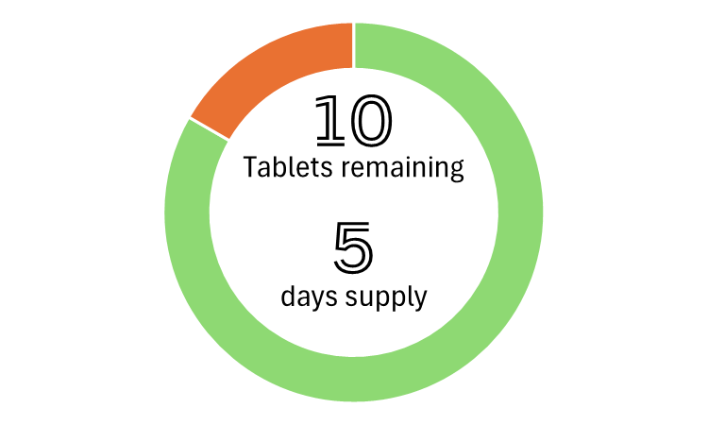


Glucophage | 1000mg | tablets
Glucophage | 1000mg | tablets
Metformin
Twice daily
Metformin
Twice daily
☼
☼
Morning
Morning
☾
☾
Evening
Evening
40 tablets remaining
20 days supply
Refill


Glucophage | 1000mg | tablets
Glucophage | 1000mg | tablets
Metformin
Twice daily
Metformin
Twice daily
☼
☼
10 tablets remaining
5 days supply
Morning
Morning
☾
☾
Evening
Evening
Refill
Order by: Thu, 1 Jul 25
Refill

Slide 3
